Slide 1
Wine Quality Analysis: Unveiling the Secrets of Good Wine
A Data-Driven Approach to Understanding Red Wine Characteristics
By ,
V YUVAN KRISHNAN

Slide 2
Project Overview & Dataset Introduction
Objective: To analyze the physicochemical properties of red wines and understand their impact on quality, ultimately building predictive models.
Dataset: "Wine Quality Dataset" (Red Wine)
Shape: 1599 rows, 12 columns
Columns: fixed acidity, volatile acidity, citric acid, residual sugar, chlorides, free sulfur dioxide, total sulfur dioxide, density, pH, sulphates, alcohol, quality.
Missing Values: No missing values, ensuring data completeness.
Data Types: All features are numerical (float64), quality is integer.

Slide 3
Understanding Wine Quality Distribution
Quality Scores: Range from 3 (lowest) to 8 (highest).
Most Frequent Quality: Quality score 5 (681 occurrences) and 6 (638 occurrences) are the most common.
Imbalance: Very few wines are rated as excellent (8) or very poor (3), indicating an imbalanced dataset. This might impact model performance for extreme quality levels.

Slide 4
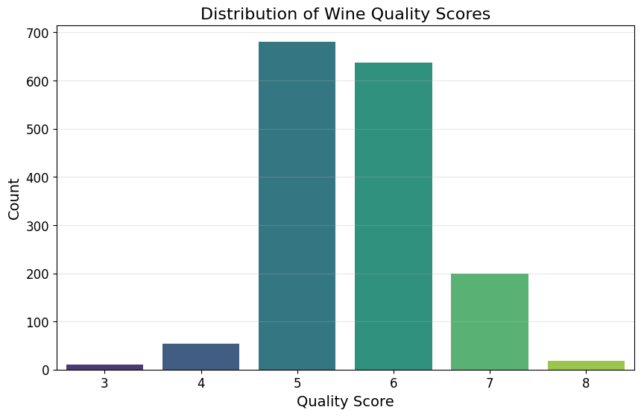

Slide 5
Key Chemical Properties & Their Impact on Quality
Correlation Matrix: Visualizing relationships between all features.
Strongest Positive Correlation with Quality:
alcohol: 0.48 (Higher alcohol content generally correlates with higher quality.)
sulphates: 0.25 (Moderate positive correlation.)
citric acid: 0.23 (Moderate positive correlation.)
Strongest Negative Correlation with Quality:
volatile acidity: -0.39 (Higher volatile acidity strongly correlates with lower quality.)
total sulfur dioxide: -0.19 (Moderate negative correlation.)
density: -0.17 (Moderate negative correlation.)
Weak/Minor Impact: fixed acidity (0.12), residual sugar (0.01), free sulfur dioxide (-0.05), pH (-0.06), chlorides (-0.13) show weaker correlations.

Slide 6
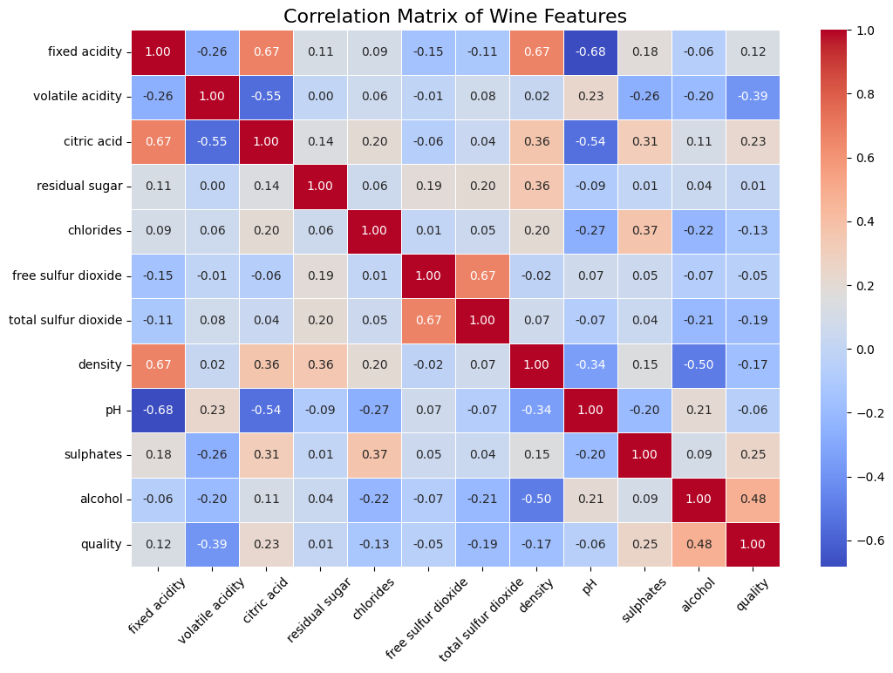

Slide 7
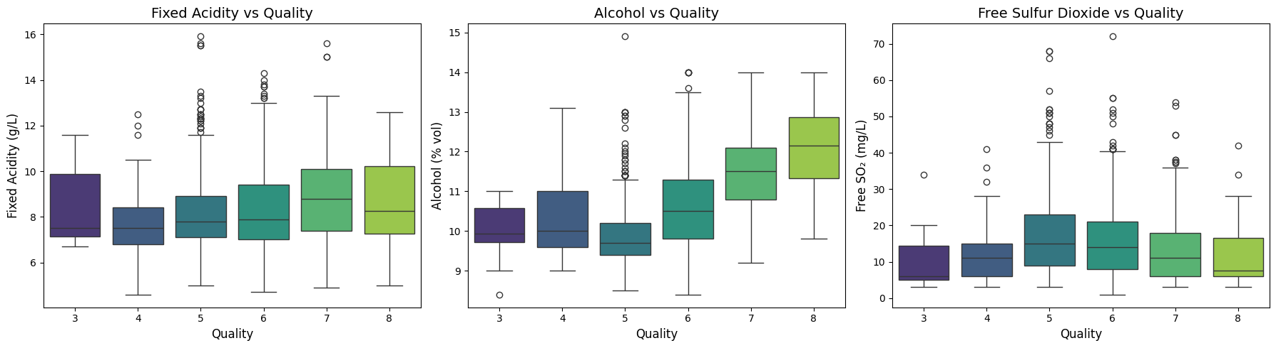

Slide 8
Specific Insights: Residual Sugar & Volatile Acidity
Residual Sugar Analysis:
Average residual sugar for best quality (8): 2.58 g/L
Average residual sugar for worst quality (3): 2.64 g/L
Observation: Higher quality wines tend to have slightly more residual sugar, but the difference is minimal and not a strong differentiator.
Volatile Acidity Effect:
Correlation with quality: -0.39 (strong negative).
Insight: Wines with higher volatile acidity tend to be rated lower in quality. This is a critical factor for winemakers to control.

Slide 9
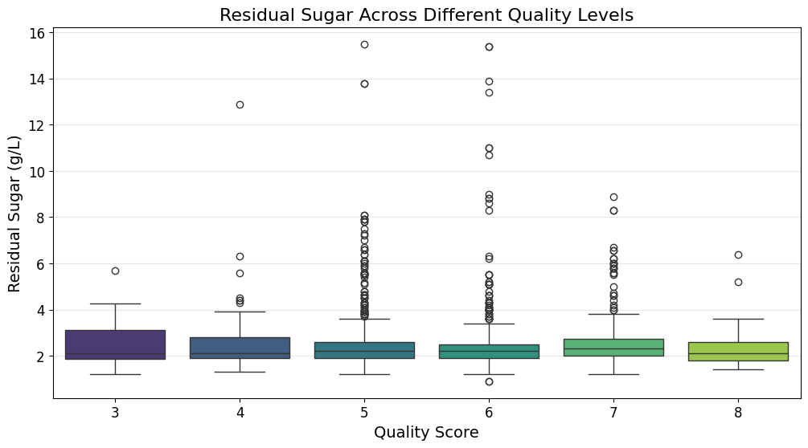
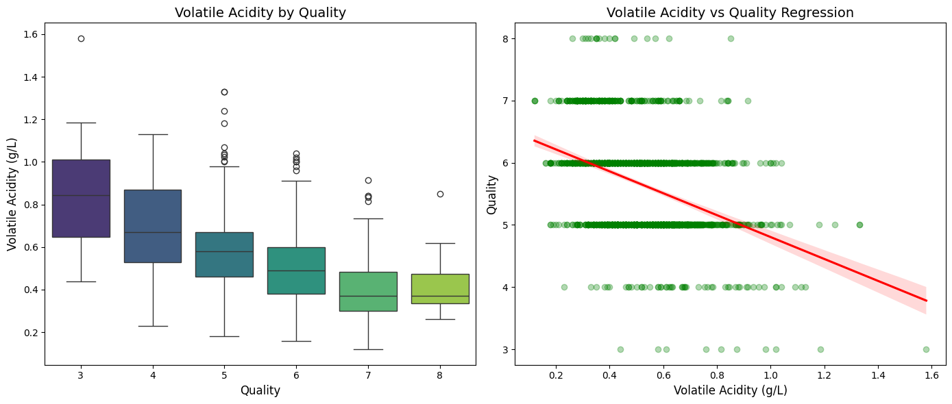

Slide 10
Predicting Wine Quality: Model Comparison
Models Used: Decision Tree Classifier and Random Forest Classifier.
Data Preparation: Features scaled using StandardScaler, data split into 80% training and 20% testing.
Decision Tree Model Performance:
Accuracy: 0.5844 (58.44%)
Struggles with minority classes (quality 3, 4, 8) as seen in the classification report (precision/recall 0.00 for these classes).
Random Forest Model Performance:
Accuracy: 0.5969 (59.69%)
Outperforms Decision Tree, indicating better generalization. Still struggles with minority classes.

Slide 11
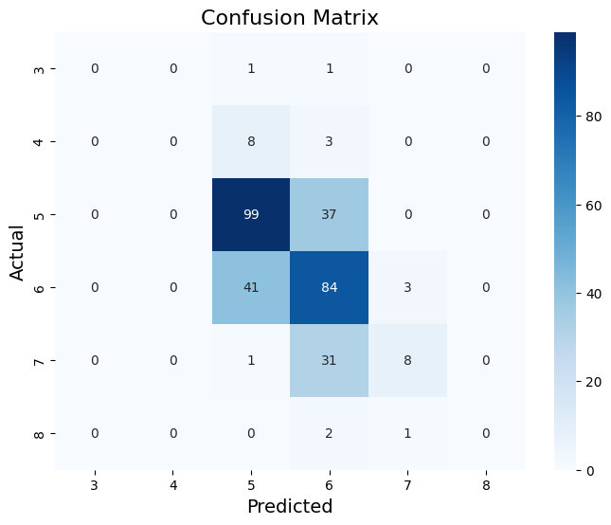
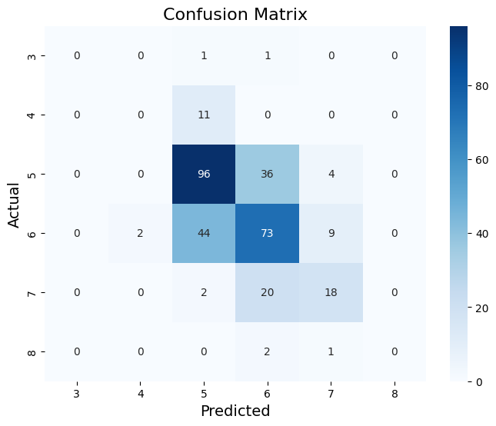

Slide 12
What Matters Most: Feature Importance
Based on the Random Forest model, the most important features for predicting wine quality are:
1. Alcohol: 0.288 (Highest importance)
2. Sulphates: 0.142
3. Total Sulfur Dioxide: 0.124
4. Volatile Acidity: 0.116
This reinforces the correlation findings: alcohol and volatile acidity are crucial determinants of wine quality.

Slide 13
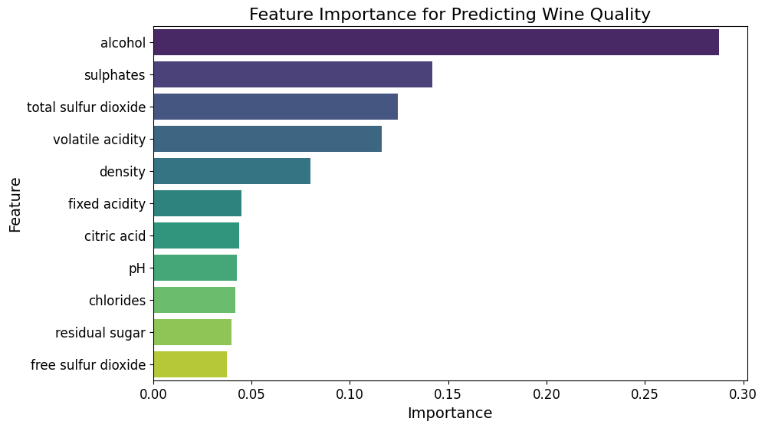

Slide 14
Further Visualizations: Unpacking Relationships
Pairplot of Top Features by Quality: Shows relationships between alcohol, volatile acidity, sulphates, citric acid, and quality, colored by quality. This helps visualize how these key features vary across different quality levels.
Alcohol Distribution by Quality: Violin plot clearly shows that higher quality wines (7 and 8) tend to have a higher median alcohol content and a broader distribution towards higher alcohol percentages.
Volatile Acidity Distribution by Quality: Violin plot demonstrates that lower quality wines (3 and 4) generally have higher volatile acidity, with the median and distribution shifting lower as quality increases.

Slide 15
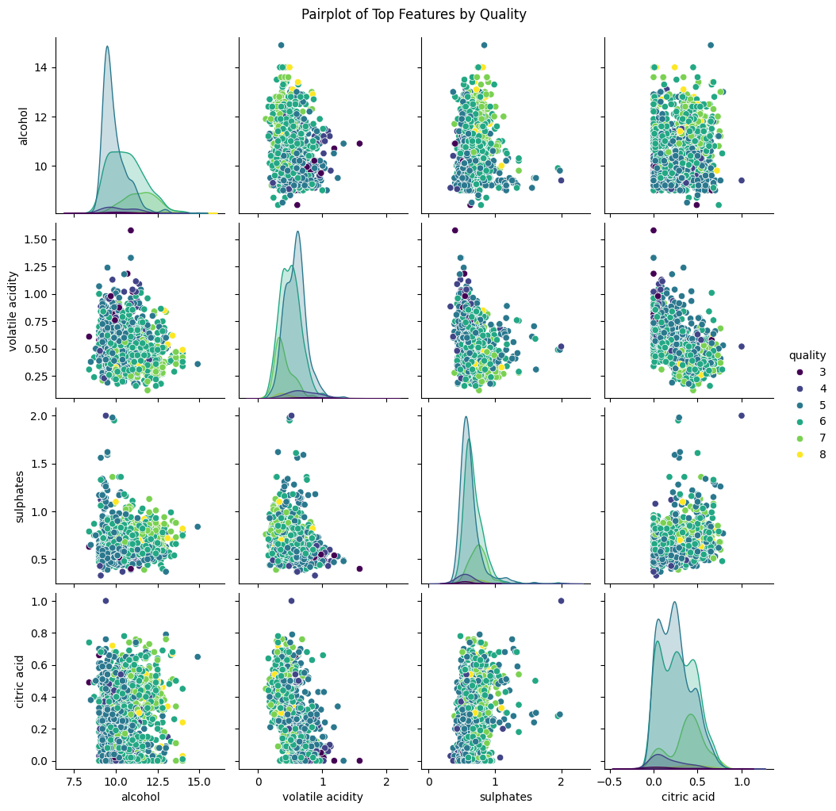

Slide 16
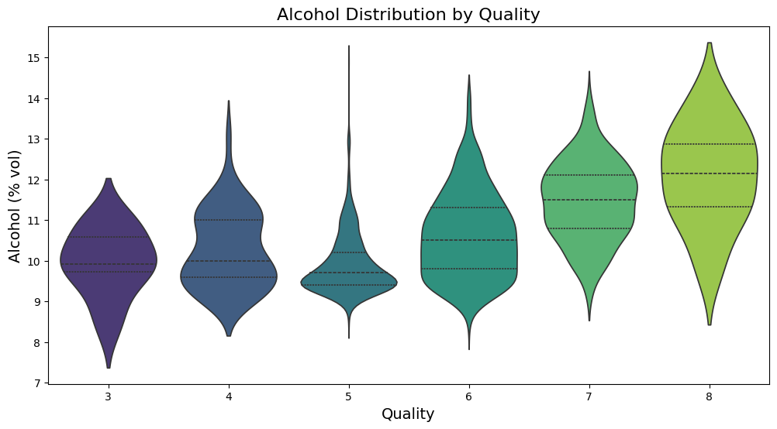
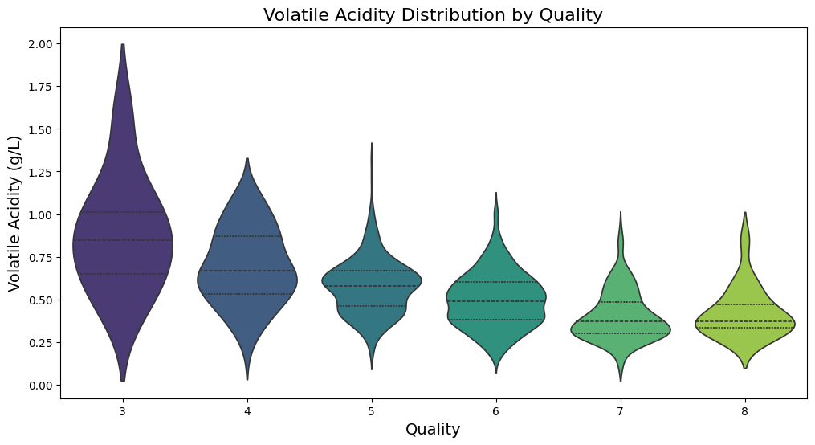

Slide 17
Key Takeaways & Actionable Recommendations
Winemaking Focus:
Alcohol Content: Aim for optimal alcohol levels, as it's the strongest positive predictor of quality.
Volatile Acidity: Strictly control and minimize volatile acidity, as it significantly degrades wine quality.
Sulphates: Maintain appropriate levels of sulphates, as they contribute positively to quality.
Quality Control: Emphasize monitoring and managing these key chemical parameters during the winemaking process.

Slide 18
Future Work & Data Science Recommendations
Addressing Imbalance: Consider grouping quality scores into broader categories (e.g., "Low" (3-4), "Medium" (5-6), "High" (7-8)) to improve model performance on extreme quality levels.
Data Collection: Collect more data, especially for wines with very high or very low quality scores, to enhance model robustness.
Advanced Modeling: Explore other machine learning algorithms (e.g., Gradient Boosting, Neural Networks) and ensemble methods for potentially higher accuracy.
Feature Engineering: Investigate creating new features from existing ones (e.g., ratios of acids) that might better capture quality nuances.

